Slide 1


INSTITUTO FEDERAL DO CEARÁ
Bacharelado em Ciencia da Computacao
Disciplina: Sociedade e Tecnologia da Informacao – março 2020
Mauro Oliveira
www.maurooliveira.com.br
Chico Anysio
Óleo sobre tela 60x40 cm

Slide 2
Aula 12 – Data Science em Saúde
1. What Is a computer?
2. What is Artificial Intelligence?
3. What Is Data Science?
4. Applications of Data Science in Healthcare
Chico Anysio
Óleo sobre tela 60x40 cm

Slide 3
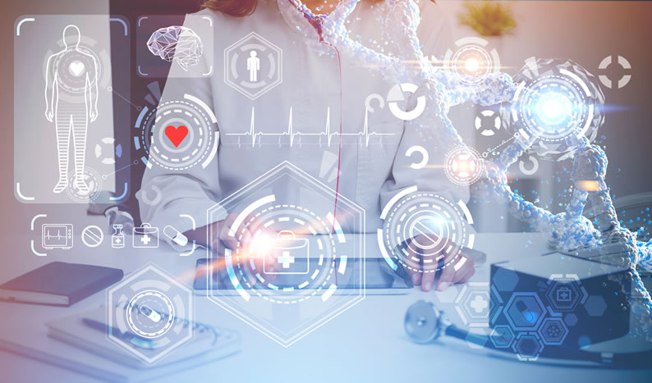
4. Applications of Data Science in Healthcare?

Slide 4
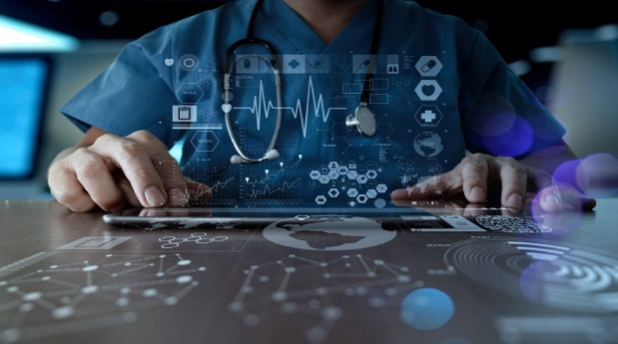
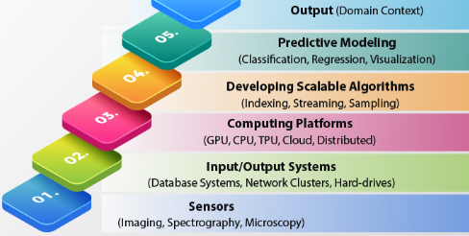
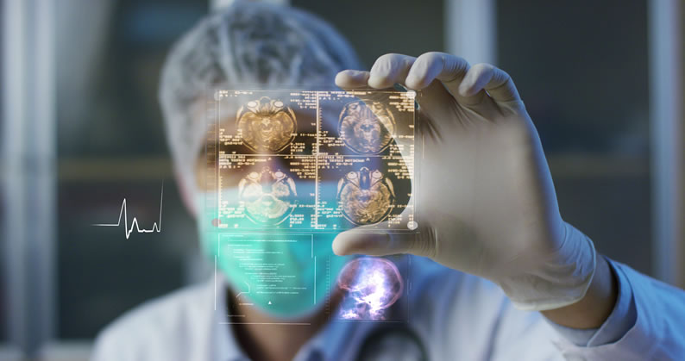
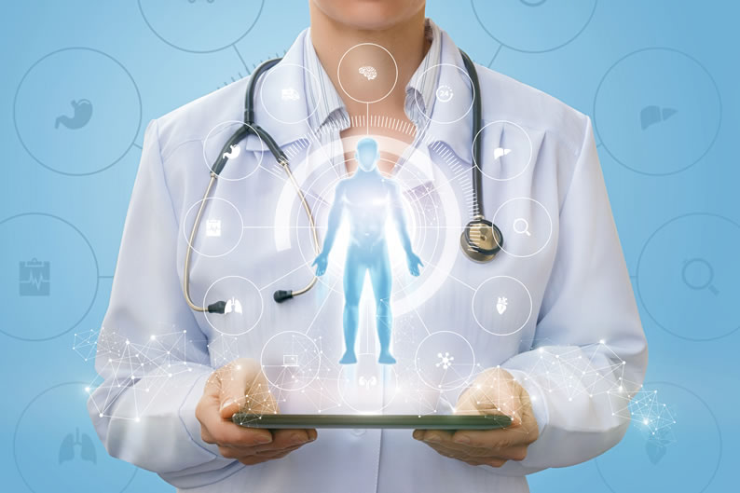
4. Applications of Data Science in Healthcare?

Slide 5
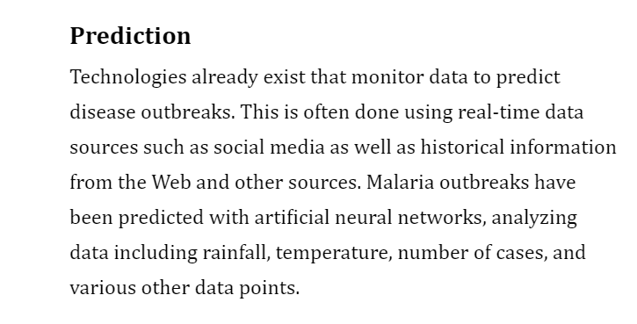
4. Applications of Data Science in Healthcare?

Slide 6
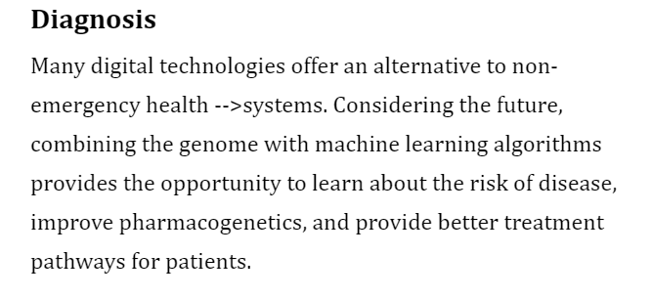
4. Applications of Data Science in Healthcare?

Slide 7
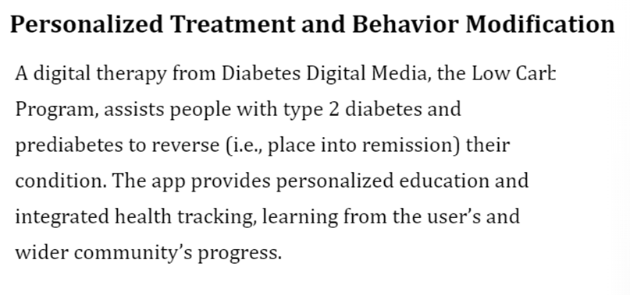
4. Applications of Data Science in Healthcare?

Slide 8
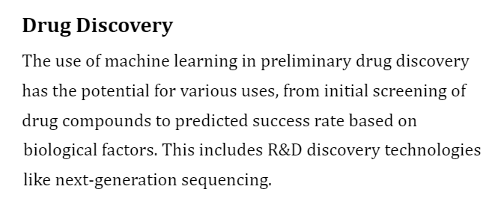
4. Applications of Data Science in Healthcare?

Slide 9
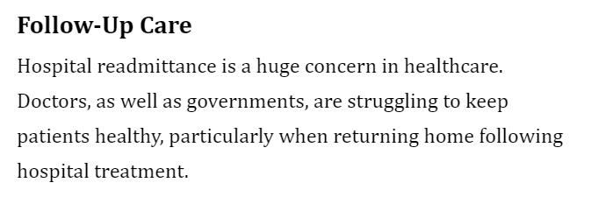
4. Applications of Data Science in Healthcare?

Slide 10
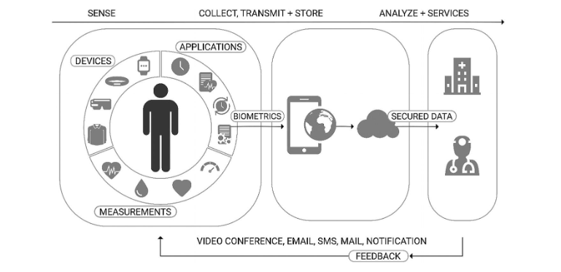
4. Applications of Data Science in Healthcare?

Slide 11
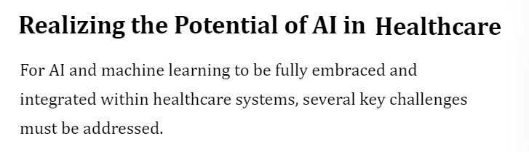
4. Applications of Data Science in Healthcare?
Understanding Gap Fragmented Data
Appropriated Security Data Governance
Bias Software

Slide 12
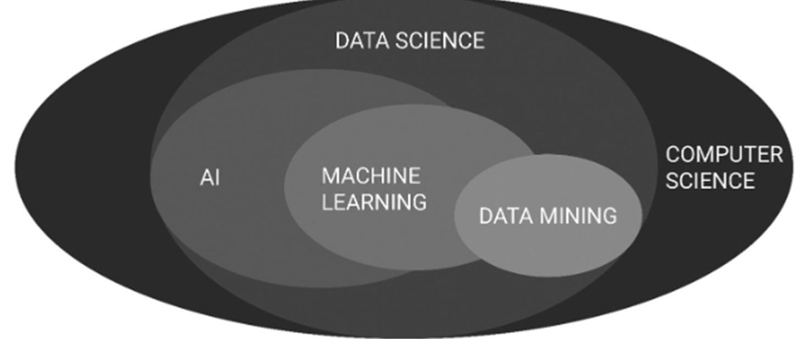
What Is Data Science?
What Is Machine
Learning?
What Is
Data
Mining?
What Is
Artificial Intelligence?
What Is
Computer Science?

Slide 13
Material bibliográfico :
Virginia Tech Courses:
http://courses.cs.vt.edu/~csonline/MachineArchitecture/Lessons/index.html
2) Livro Texto: Machine Learning and AI for Healthcare: Big Data for Improved Health Outcomes - Arjun Panesar. APress, 2019
3) Artigos:
Turing: “On Computable Numbers, With An Application To The Entscheidungsproblem”
https://www.cs.virginia.edu/~robins/Turing_Paper_1936.pdf
Artificial Intelligence, Machine Learning, Deep Learning, and Cognitive Computing: What Do These Terms Mean and How Will They Impact Health Care? https://www.arthroplastyjournal.org/action/showPdf?pii=S0883-5403%2818%2930215-8
4) Slides:
Ultra-modern medicine: examples of machine learning in healthcare
https://builtin.com/artificial-intelligence/machine-learning-healthcare
Top 10 applications of machine learning in healthcare
https://www.flatworldsolutions.com/healthcare/articles/top-10-applications-of-machine-learning-in-healthcare.php
5 Ways Machine learning is Redefining Healthcare
https://www.entrepreneur.com/article/341626
5) Video:
George Dyson at the birth of the computer”
https://www.ted.com/talks/george_dyson_the_birth_of_the_computer
Better Medicine Through Machine Learning | Suchi Saria | TEDxBoston
https://www.youtube.com/watch?v=Nj2YSLPn6OY

