Slide 1


INSTITUTO FEDERAL DO CEARÁ
Bacharelado em Ciencia da Computacao
Disciplina: Sociedade e Tecnologia da Informacao – março 2020
Mauro Oliveira
www.maurooliveira.com.br
Chico Anysio
Óleo sobre tela 60x40 cm

Slide 2
Aula 12 – Data Science em Saúde
1. What Is a computer?
2. What is Artificial Intelligence?
3. What Is Data Science?
4. Applications of Data Science in Healthcare
Chico Anysio
Óleo sobre tela 60x40 cm

Slide 3
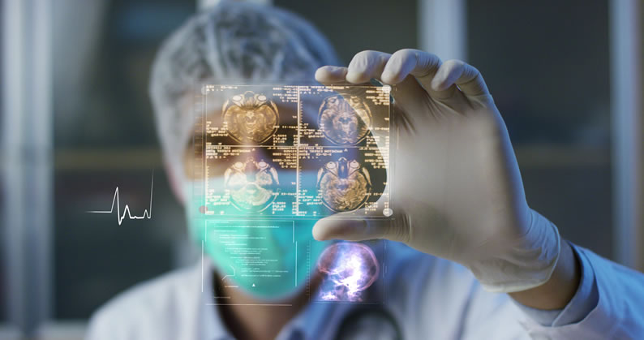
3. What Is Data Science?

Slide 4
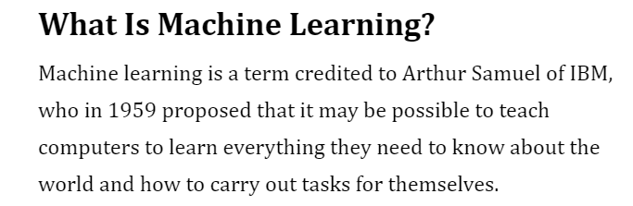
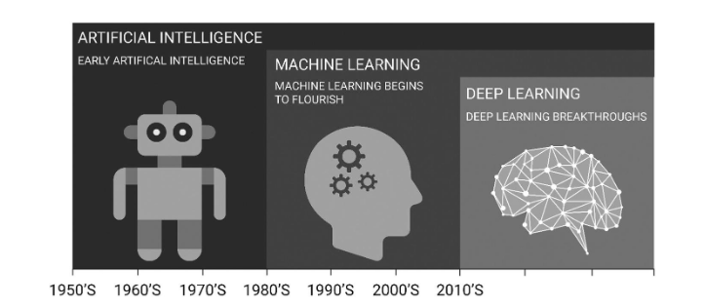
3. What Is Data Science?

Slide 5
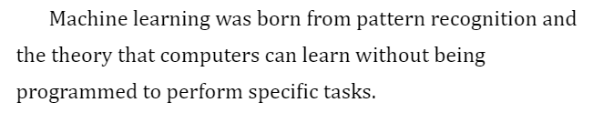
3. What Is Data Science?
Bayesian methods
Neural Networks
Inductive logic programming
Explanation-based,
Natural language processing
Decision tree
Reinforcement learning

Slide 6
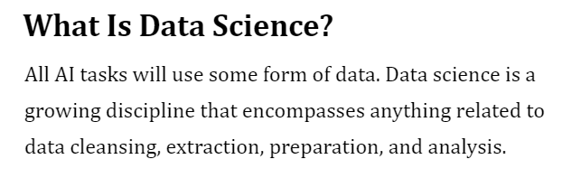
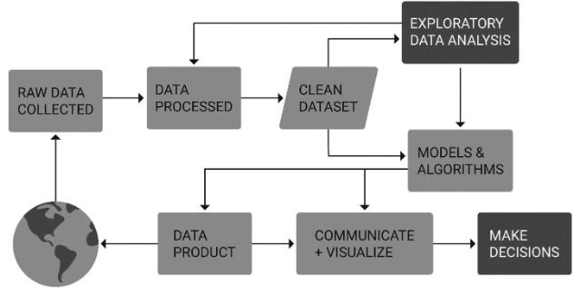
3. What Is Data Science?

Slide 7
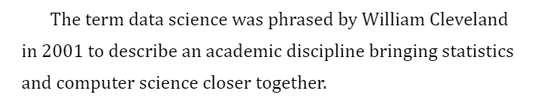
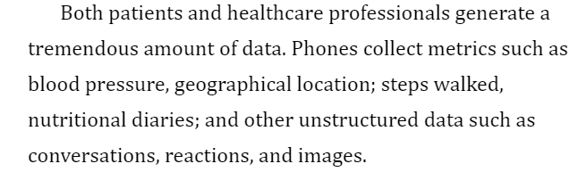
3. What Is Data Science?

Slide 8
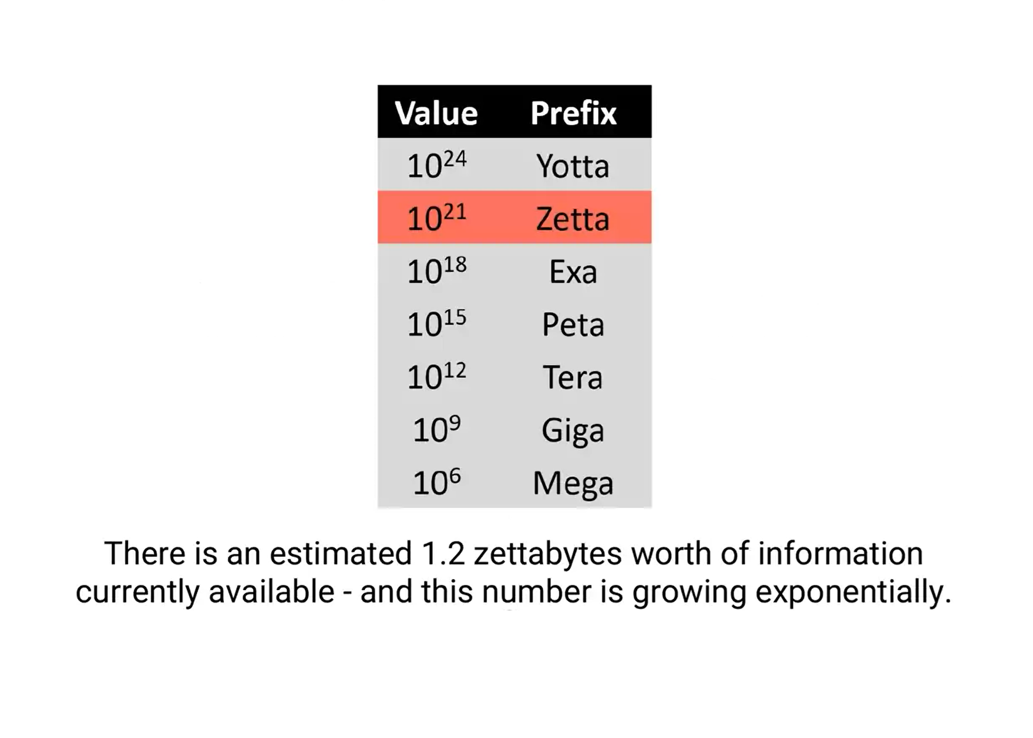
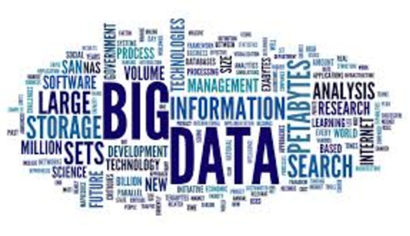
3. What Is Data Science?

Slide 9
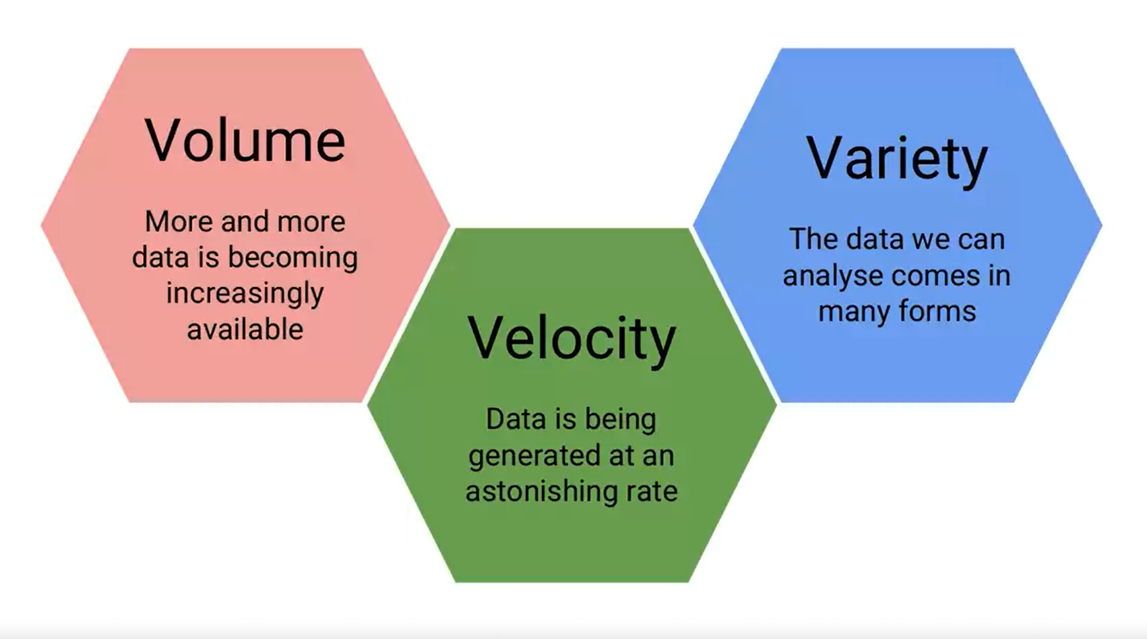
3. What Is Data Science?

Slide 10
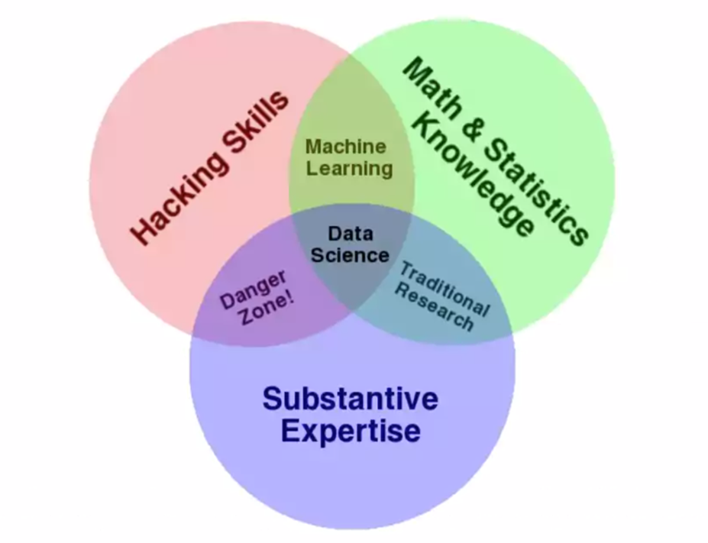
3. What Is Data Science?

Slide 11
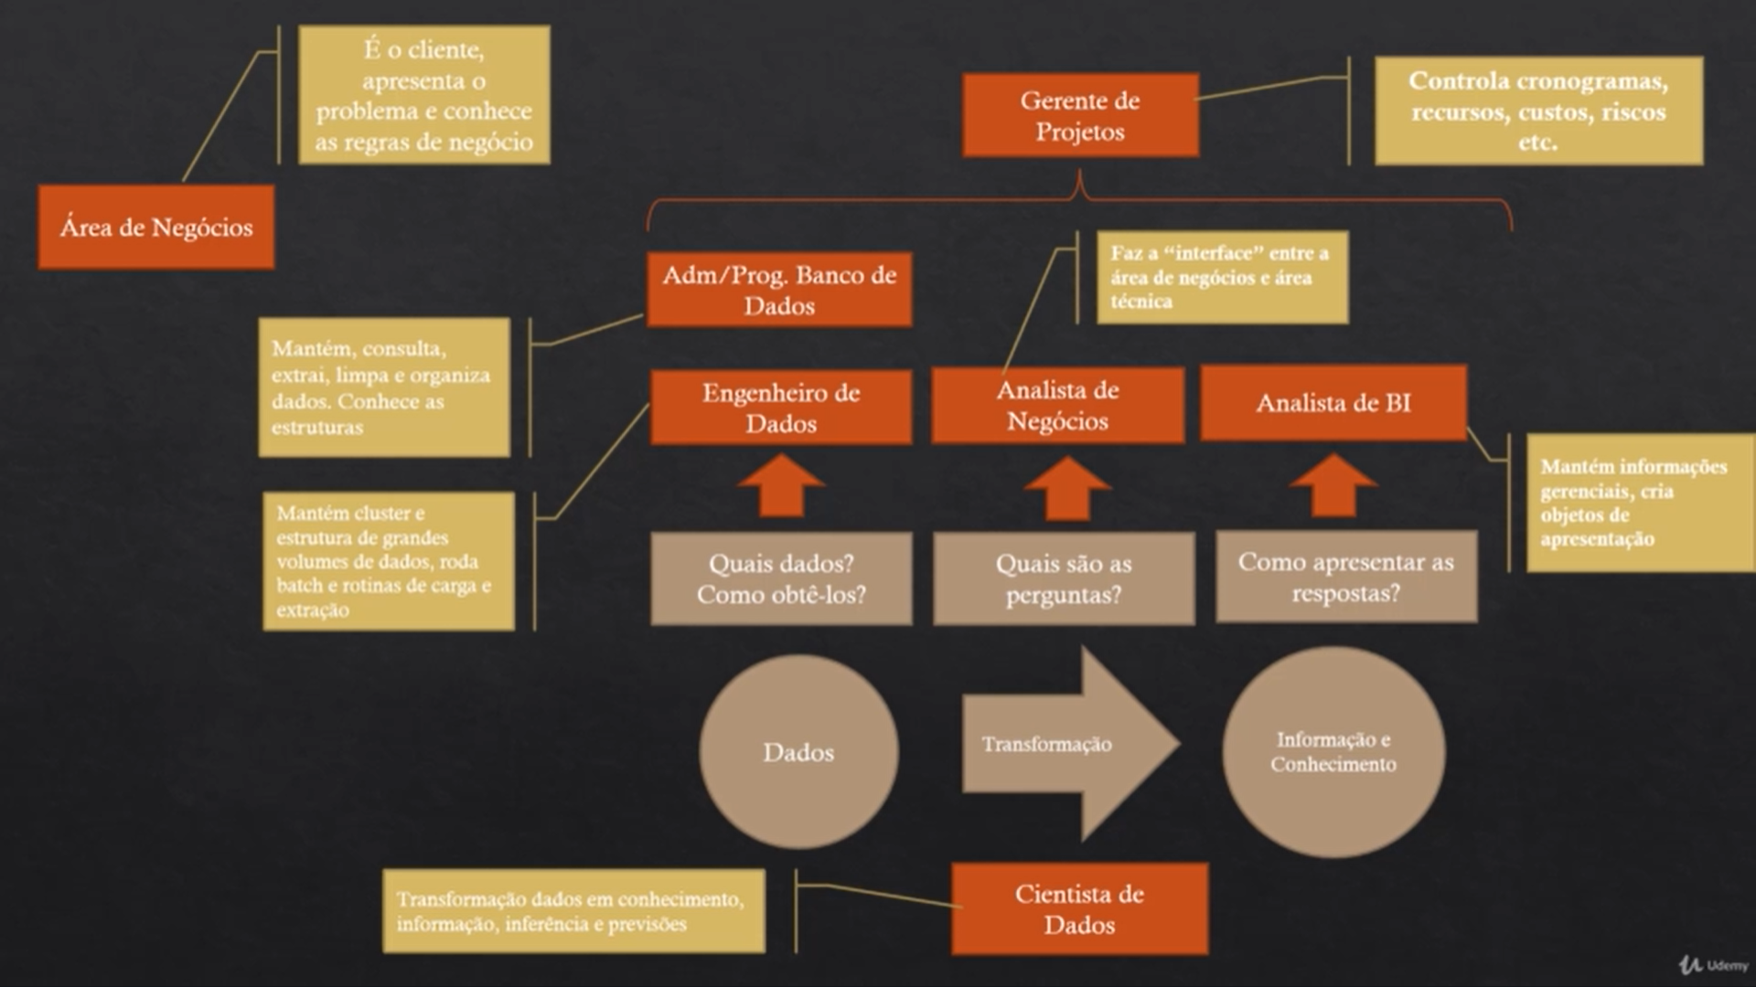

Slide 12
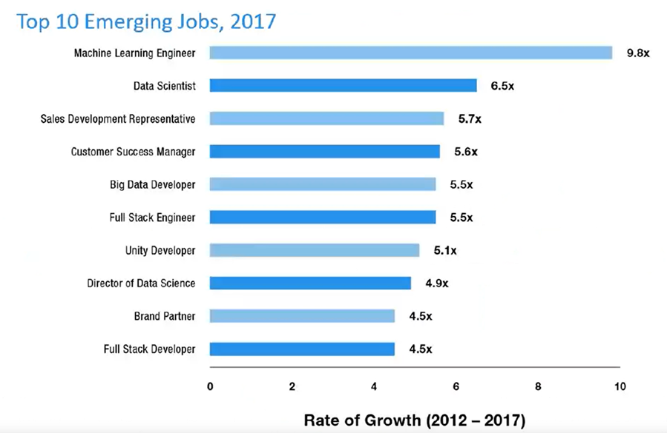
3. What Is Data Science?

