Slide 1


INSTITUTO FEDERAL DO CEARÁ
Bacharelado em Ciencia da Computacao
Disciplina: Sociedade e Tecnologia da Informacao – março 2020
Mauro Oliveira
www.maurooliveira.com.br
Chico Anysio
Óleo sobre tela 60x40 cm

Slide 2
Aula 12 – Data Science em Saúde
1. What Is a computer?
2. What is Artificial Intelligence?
3. What Is Data Science?
4. Applications of Data Science in Healthcare
Chico Anysio
Óleo sobre tela 60x40 cm

Slide 3

2. What Is Artificial Intelligence?

Slide 4
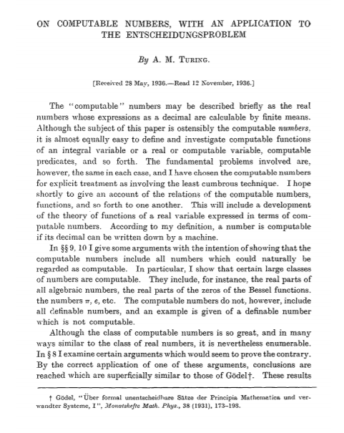
2. What Is Artificial Intelligence?
1950 when British pioneer Alan Turing published Computing Machinery and Intelligence in which he asked, can machines think?
AI is a subset of computer science that has origins in mathematics, logic, philosophy, psychology, cognitive science, and biology, among others

Slide 5


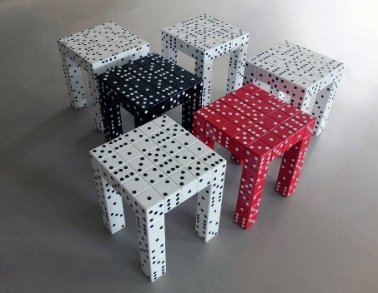
2. What Is Artificial Intelligence?
The term AI was first coined in 1956 by Professor John McCarthy of Dartmouth College.
Professor McCarthy proposed a summer research project based on the idea that “every aspect of learning or any other feature of intelligence can in principle be so precisely described that a machine can be made to simulate it”.
Files
Expert Systems
Neural Network
Fuzzy Logical
Genetic Algorithms
…
Machine Learning
Data Science
Databases

Slide 6
2. What Is Artificial Intelligence?
Getting a system to reason rationally. Techniques include automated reasoning, proof planning, constraint solving, and case-based reasoning.
Getting a program to learn, discover and predict. Techniques include machine learning, data mining (search), and scientific knowledge discovery.
Getting a program to play games. Techniques include minimax search and alpha-beta pruning.
Getting a program to communicate with humans. Techniques include natural language processing (NLP).
Getting a program to exhibit signs of life. Techniques include genetic algorithms.
Enabling machines to navigate intelligently in the world
This involves robotic techniques such as planning and vision.
Expert Systems
Neural Network
Fuzzy Logical
Genetic Algorithms
…
Machine Learning
Data Science

Slide 7
2. What Is Artificial Intelligence?
Four Distinctive Categories of Artificial Intelligence
Reactive Machines
  Deep Blue, the chess-playing IBM supercomputer (It beat Kasparov en 1996).
Limited Memory
  System that think and Act Rationally
Theory of Mind
  Systems that think like human
Self-Aware Artificial Intelligence
  Systems that are human
Expert Systems
Neural Network
Fuzzy Logical
Genetic Algorithms
…
Machine Learning
Data Science

