Slide 1





MPCOMP
MPCOMP
Master Program on
Computer Science
Ceará - Brasil
EVOLVING AN INTELLIGENT FRAMEWORK
FOR DECISION- MAKING PROCESS IN E-HEALTH SYSTEMS
MAURO OLIVEIRA
www.maurooliveira.com.br
LAR-A
Computer Network Laboratory of Aracati
Notes:
I would like to thank all of you to be here, it is a pleasure for me to present this paper today. My name is Leonardo Gardini, I am from Fortaleza, a northeast city in Brazil. My professor and mentor is also here, Mauro Oliveira. He is from Aracati, a city near Fortaleza. This picture was taken there. This work is being conducted by the Computer Network Laboratory of Aracati, which acronim is LARA.

Slide 2
Team working on this project
EVOLVING AN INTELLIGENT FRAMEWORK FOR
DECISION- MAKING PROCESS IN E-HEALTH SYSTEMS
Leonardo Gardini State University of Ceara (UECE) Fortaleza, Brazil lgardini@gmail.com | Germanno Teles Federal University of Ceara (UFC) Fortaleza, Brazil gemanno@gmail.com | Ronaldo Ramos Federal Institute of Ceará (IFCE) Fortaleza, Brazil ronaldoramos@gmail.com | Cesar Moura Federal Institute of Ceará (IFCE) Fortaleza, Brazil cesar@edu.ifce.br
Reinaldo Braga Federal Institute of Ceará (IFCE) Aracati, Brazil reinaldobraga@gmail.com | José Bringel Federal University of Ceara (UFC) Fortaleza, Brazil bringelfilho@gmail.com | Odorico Andrade Federal University of Ceara (UFC) Fortaleza, Brazil odorico0811@gmail.com | Mauro Oliveira Federal Institute of Ceará (IFCE) Aracati, Brazil amauroboliveira@gmail.com
Notes:
That is the whole team that is working on this project, and I also would like to emphasize the participation of professor Herve Martin, from the Joseph Fourier University, in Grenoble, France.

Slide 3

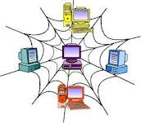

About this lecture …
LARIISA is an intelligent framework for enhancing the decision making process on the health public system.
    This lecture presents the evolution of LARIISA towards an intelligent classifier model and the new Cube architecture.
Notes:
Those are the main topics of the presentation, and please if you have any doubt or question, raise your hand.

Slide 4
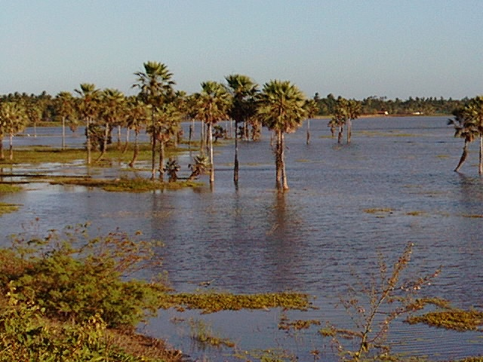
Summary
1. Contextualization
2. LARIISA Solution (2010)
3. Ontology and Health Application
4. LARIISA Architecture
5. LARIISA Prototypes
- Dengue fever study case (2012)
- A Bayesian Approach (2013)
- Caregiving (2014)
- Car Aciddent (2015)
6. LARIISA Next Generation
- An Intelligent Classifier for LARIISA
- LARIISA Cube Architecture
7. Conclusion
Notes:
Those are the main topics of the presentation, and please if you have any doubt or question, raise your hand.

Slide 5
1. Contextualization

Slide 6

Health System’s Evolution
Fonte: K. Jennings, K. Miller, S. Materna (1997)
Cost
Industrial Era
Information Era
Cost
¢
$
$
¢
Disease Treatment
Disease Prevention
HOSPITAL
HOMECARE

Slide 7


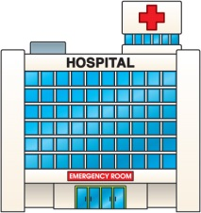
CONTEXTUALIZATION
Health System - Information Era
Based on Disease PREVENTION
Encouraged
Costs
¢
Primary Health Care
Descentralization of Public Health System
Health Agent
$
Hospital (specialits)
Discouraged
Fonte: K. Jennings, K. Miller, S. Materna (1997)
Notes:
During the Industrial Era, health managers concentrated their efforts toward hospitals, but this approach increases the complexity in health management, and costs for public health. The main focus, during the Industrial Era, were in disease treatment, and not in disease prevention. But then, in the information era, health managers focus on Primary health care, that is based on disease prevention. The pyramide was inverted, and now the efforts are in Primary health care. So, the main focus nowadays is Descentralization of Public Health System – a challange for health management.

Slide 8
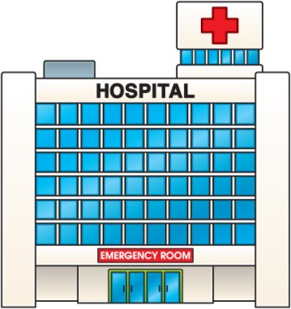
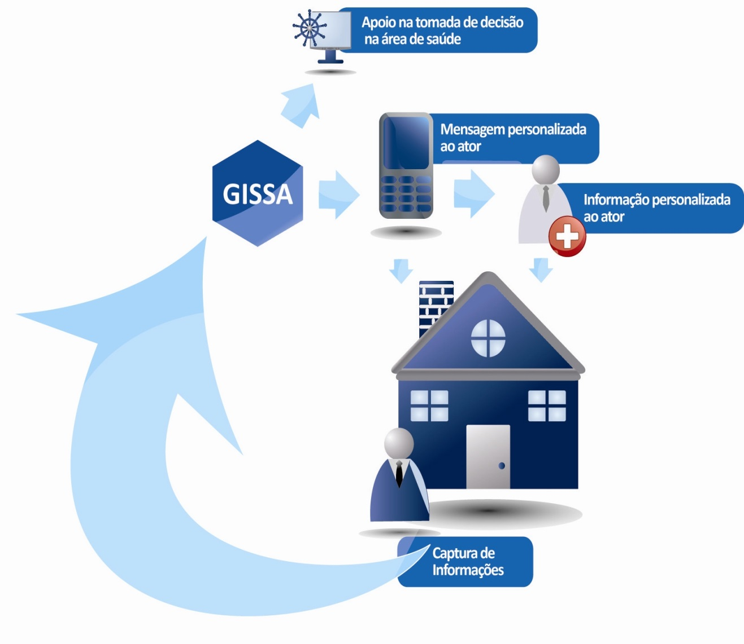
DESCENTRALIZATION →
PROBLEM
Hospital
(specialits)
Message
Management
Increasing Complexity of
Health Management
Information
Health
Agent
Primary
Health Care
Data Acquisition
Notes:
As you can see, focus on disease prevention requires acquiring data from patients using medical sensor, context providers, and so on. Focusing on disease prevention is not a simple task.

Slide 9
2. The LARIISA Solution

Slide 10




GENESIS of the LARIISA Project
The objective of the LARIISA is to provide a software platform that allows the decision-making model for public health system.
Decision-making
Application
Health Knowledge
Context-aware
Technology
Inference
Mechanism
Real Time
Information

Slide 11
DESCENTRALIZATION →
PROBLEM →
SOLUTION
CONTEXT-AWARE FRAMEWORK
Decision-Making
ONTOLOGY
Knowledge
Representation
Information
Inference Mechanism
LARIISA: an Intelligent System to support decision-making process
Health Knowledge
Geolocation
Metadata
Notes:
In order to solve this problem, we present LARIISA, a context-aware framework. And also, CLARIISA, a part of this project where collecting data and enrich this data with context is
Solução – Sistema Inteligente para apoiar a tomada de decisão
AQUI APRESENTO OS QUATRO ELEMENTOS DO LARIISA (2009) ONDE É USADAO ONLOLGIA E CONTEXT AWARENESS COMO CONCEITOS CHAVE

Slide 12

LARIISA, A Context-Aware Framework for Health Care Governance
Decision-Making Systems: A model based on the Brazilian Digital TV
Mauro Oliveira & Odorico Monteiro

Slide 13






Knowledge
Management
INTELLIGENCE FOR
DECISION- MAKING PROCESS IN
E-HEALTH SYSTEMS
Shared
Information
Normative
Administration
Clinical Epidemiology

Slide 14
3. Ontology and
Health Application

Slide 15
Why do we need Ontologies in healthcare Aplication?
REPRESENTING INFORMATION
REAL INFORMATION
Semantic INTEROPERABILITY Problem
An ontology is a "formal, explicit specification of a shared conceptualisation".
It formally represents knowledge as a set of concepts within a domain, and the relationships between theses concepts.
It can be used to model a domain and support reasoning about concepts

Slide 16
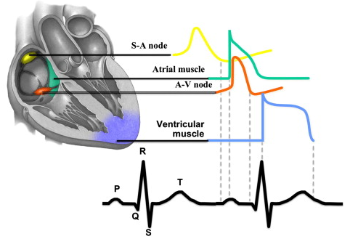
Why do we need Ontologies in healthcare Aplication?
ELECTROCARDIOGRAM
PROBLEM: Data integration with diferent standards
  AHA/MIT-BIH (Physionet)
  SCP-ECG (ISO/DIS 11073-91064)
  HL7 aECG
Notes:
A simples existência de padrões em uma determinada área não é suficiente para garantir interoperabilidade semântica. Em primeiro lugar, porque padrões geralmente cobrem um aspecto (viewpoint) particular do domínio, com objetivo de facilitar a manipulação de informações para uma classe específica de aplicações. Em segundo lugar, padrões são influenciados por muitas critérios não técnicos de design – incluindo aderência a uma determinada linguagem ou conformidade com padrões da mesma organização;
Caso real reportado em detalhes em: GONÇALVES, B.N.; GUIZZARDI, G.; PEREIRA FILHO, J.G., Using an ECG reference ontology for semantic interoperability of ECG data, Journal of Biomedical Informatics, Special Issue on Ontologies for Clinical and Translational Research, Editors: Barry Smith, Werner Ceusters and Richard H. Scheuermann, Elsevier, 2011.

Slide 17
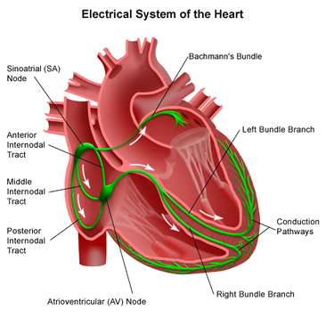
Why do we need Ontologies in healthcare Aplication?
Ontology
AHA/MIT-BIH
SCP-ECG
HL7 aECG
Notes:
Com essa estratégia obteve-se o sucesso de integração desses padrões

Slide 18
Why do we need Ontologies in healthcare Aplication?
Reference
Model
Standard1
Standard2
Standard3
Standard4
Notes:
Temos vários padrões, cada um com seus conceitos. O que ocorre quando utilizamos ontologias é um mapeamento desses conceitos para um MODELO DE REFERÊNCIA.

Slide 19

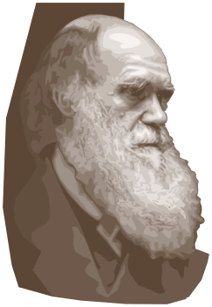
Semantic Distance
Conceptualization
Interpretation
Tan Tan Tan TAN...

Slide 20
Semantic Distance
Conceitualization
Interpretation

Slide 21
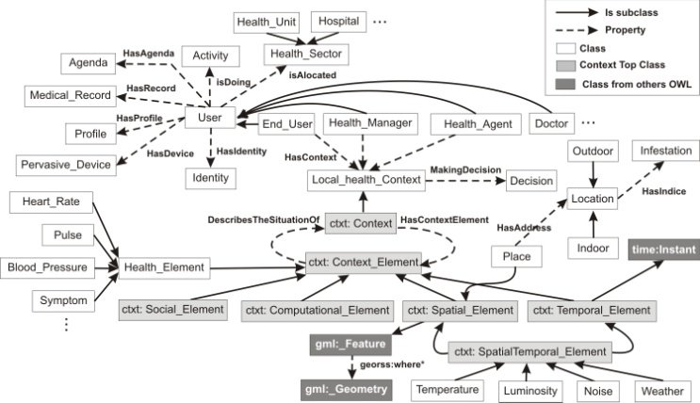

LARIISA Local health context model
Prague, Czech Republic July/2013

Slide 22
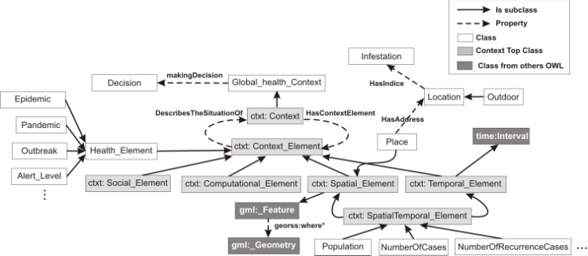
LARIISA Global health context model
Prague, Czech Republic July/2013

Slide 23
4. LARIISA Architecture

Slide 24
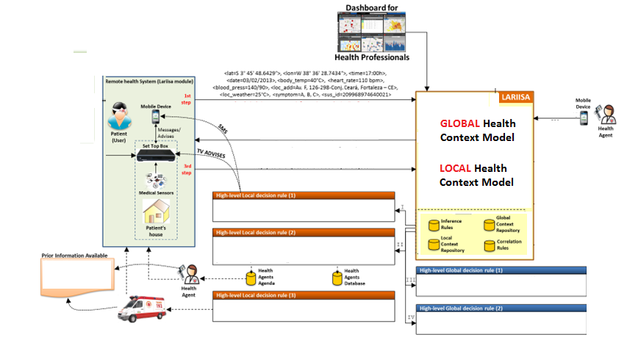
LARIISA’s Scenario
Knowledge Representation
(ONTOLOGY)
Data Acquisition
(CONTEXT)
METADATA
DECISION-MAKING
Notes:
Here you can see the whole vision of the proposed system, where data collected from patients (it is important to notice that the system can be used by users/patients, health agents and health managers or specialists) are sent to the LARIISA database, and then the system is able to take decisions taking into account local context (related to individuals) or global context (related to epidemic cases). System can take the decision to just advise the patient to go to the nearest hospital center, or send a health agent to visit the patient, or in an urgent case send an ambulance to the patient.

Slide 25
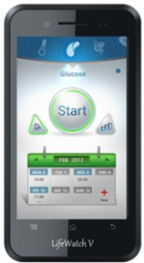

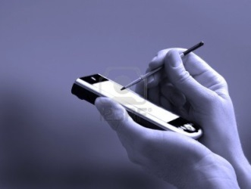


LARIISA Architecture: a context-aware framework
Data Acquisition
Context Providers
User
Device
Internet
Health Agent Device
Symptoms + sus_id
Data Processing
Metadata
Publishing
Security Protocol
Context Aggregator (CA)
Inference Rules
Global Context
Local
Context
Health Managers System
Notes:
The whole arquitecture of the system is presented here. Data Acquisition collects and enriches all important data to provide a diagnosis of the patient. Data processing layer then builds the metadata, and this metadata is sent to the database. To address privacy problem, all data are transmitted thorugh the Internet using TLS protocol. As you can notice here, the system is also able to rise additional questions to the patient according with his or her vital signs and symptoms.

Slide 26
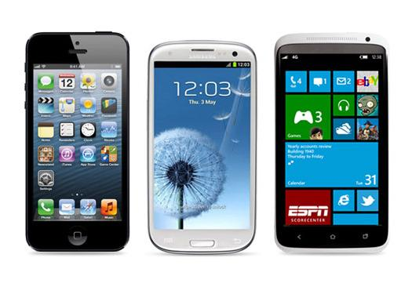
LARIISA proposes a Context-Aware Web Content Generator Based on Personal Tracking
Humidity Sensor
Temperature Sensor
Atmospheric Pressure Sensor
Accelerometer
Global Positioning System (GPS)
Internet Connection
Compass
Digital Camera
Light Sensor
Geographical Information System (GIS)
Proximity Sensor
Gyroscope
...many device sensors to explore and collect information from users...

Slide 27
Digital Camera
Global Positioning System (GPS)
Internet Connection
Proximity Sensor
Compass
Gyroscope
Accelerometer
Light Sensor
Temperature Sensor
Humidity Sensor
Geographical Information System (GIS)
Atmospheric Pressure Sensor
Medical Sensors

Slide 28

LARIISA
META
DATA
The diagnosis <0023821992> was taken at <S 3° 45' 48.6429“>, <W 38° 36' 28.7434“>, <Av. F, 126-298-Conj. Ceará, Fortaleza – CE> on <March 2nd, 2013> at <17:00h>. Heart rate was <110 bpm>, body temperature was <40°C> and blood pressure was <140/90>. Symptoms: <A, B, C>. SUS ID: <209968974640021>.
<diagnosis_id>0023821992</diagnosis_id>
<lat>3° 45' 48.6429"</lat>
Personal Tracking
<lon>38° 36' 28.7434"</lon>
<time>17:00</time>
via Web Service
<date>03/02/2013</date>
<body_temp>40°C</body_temp>
Diagnosis data
<heart_rate>110bpm</heart_rate>
<blood_pressure>140/90</blood_pressure>
metadata file
<loc_name>Av. F, 126-298-Conj. Ceará, Fortaleza - CE</loc_name>
<symptom>A, B, C</symptom>
Patient Identification!!
<sus_id>209968974640021</sus_id>

Slide 29
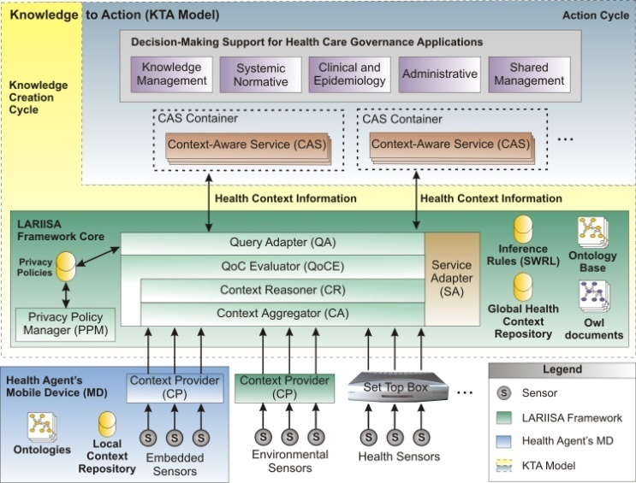

Slide 30
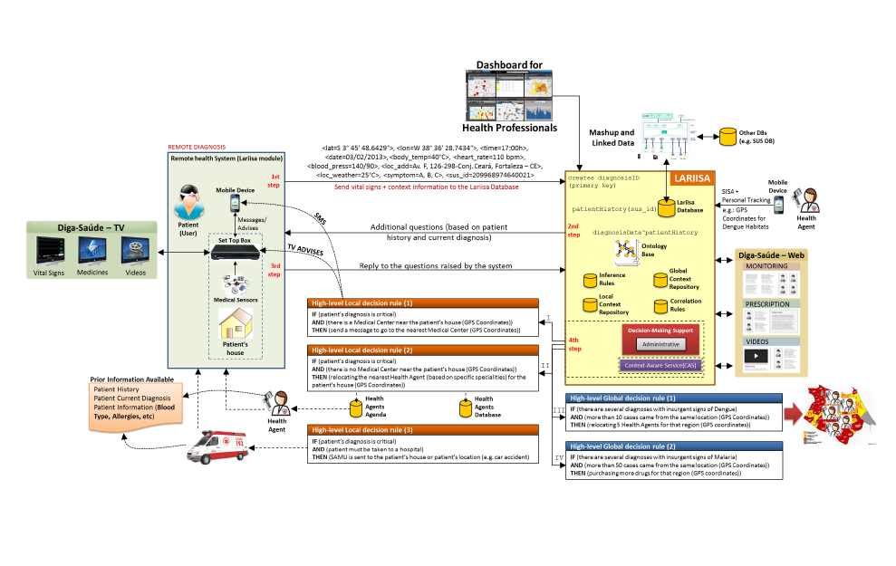
LARIISA’s Scenario
Knowledge Representation
(ONTOLOGY)
Data Acquisition
(CONTEXT)
METADATA
Step 1
LARIISA:
A Context-aware Framework
Based on Ontology Technology
Step 2
DECISION-MAKING
Step 3
Notes:
Here you can see the whole vision of the proposed system, where data collected from patients (it is important to notice that the system can be used by users/patients, health agents and health managers or specialists) are sent to the LARIISA database, and then the system is able to take decisions taking into account local context (related to individuals) or global context (related to epidemic cases). System can take the decision to just advise the patient to go to the nearest hospital center, or send a health agent to visit the patient, or in an urgent case send an ambulance to the patient.

Slide 31
5. LARIISA Prototypes

Slide 32
5. LARIISA Prototypes
- Dengue fever study case (2012)

Slide 33
LARIISA: Dengue Fever Case Study
Knowledge Representation
(ONTOLOGY)
Data Acquisition
(CONTEXT)
METADATA
Step 1
Step 2
DECISION-MAKING
Step 3
Notes:
Here you can see the whole vision of the proposed system, where data collected from patients (it is important to notice that the system can be used by users/patients, health agents and health managers or specialists) are sent to the LARIISA database, and then the system is able to take decisions taking into account local context (related to individuals) or global context (related to epidemic cases). System can take the decision to just advise the patient to go to the nearest hospital center, or send a health agent to visit the patient, or in an urgent case send an ambulance to the patient.

Slide 34
Local health context model
Prague, Czech Republic July/2013

Slide 35
Global health context model
Prague, Czech Republic July/2013

Slide 36
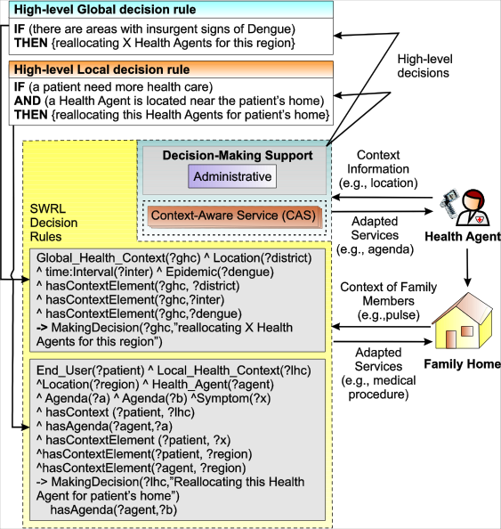
LARIISA: Dengue Fever Case Study
Local health context model
Metadata
Global health context model

Slide 37
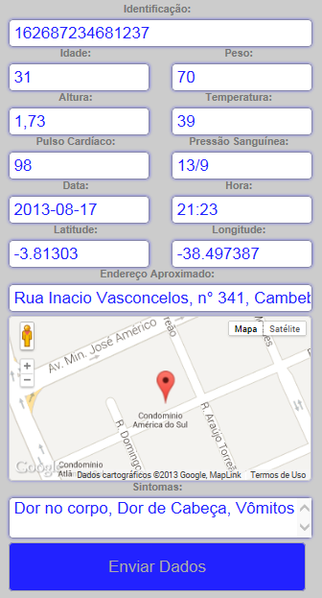
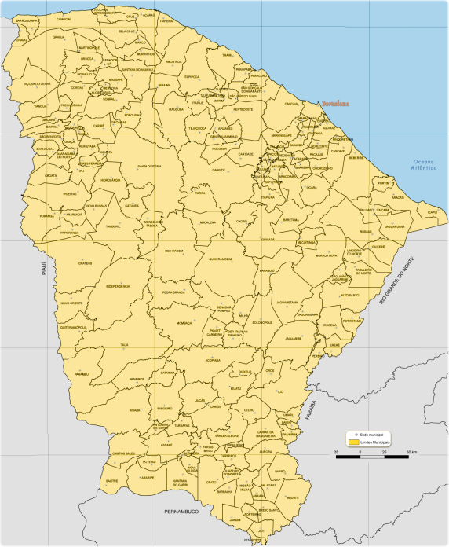






WEB Prototype
Structured Data
<lat=S 3° 45' 48.6429“>, <lon=W 38° 36' 28.7434“>, <time=17:00h>, <date=03/02/2013>, <body_temp=40°C>, <heart_rate=110 bpm>, <blood_press=140/90>, <loc_add=Av. F, 126-298-Conj. Ceará, Fortaleza – CE>, <loc_weather=25°C>, <symptom=A, B, C>, <sus_id=209968974640021>
Internet
Lariisa Database
Smartphone / Tablet / Desktop
Health Managers Dashboard
Health Agent
Pacient
Notes:
The system gives you an interface to collect diagnosis data, geolocation and an unique number (SUS_ID)

Slide 38
5. LARIISA Prototypes
- A Bayesian Approach (2013)

Slide 39
LARIISA: Bayesian Approach
Probabilistc Methods
(BAYESIAN NETWORK)
Data Acquisition
(CONTEXT)
METADATA
DECISION-MAKING
Notes:
CONTRIBUI;CÃO
A UM CENARIO QUE O SISTEMA TOMA UMA DAS 3 DECISÕES. NESTE NAO FOI DITO COMO O SISTEMA FAZ ISSO!. O MEU TRABALAHO APRESENTA UM INSTRUMENTO DE PROBABILIDADE REDES BAYESIANAS

Slide 40
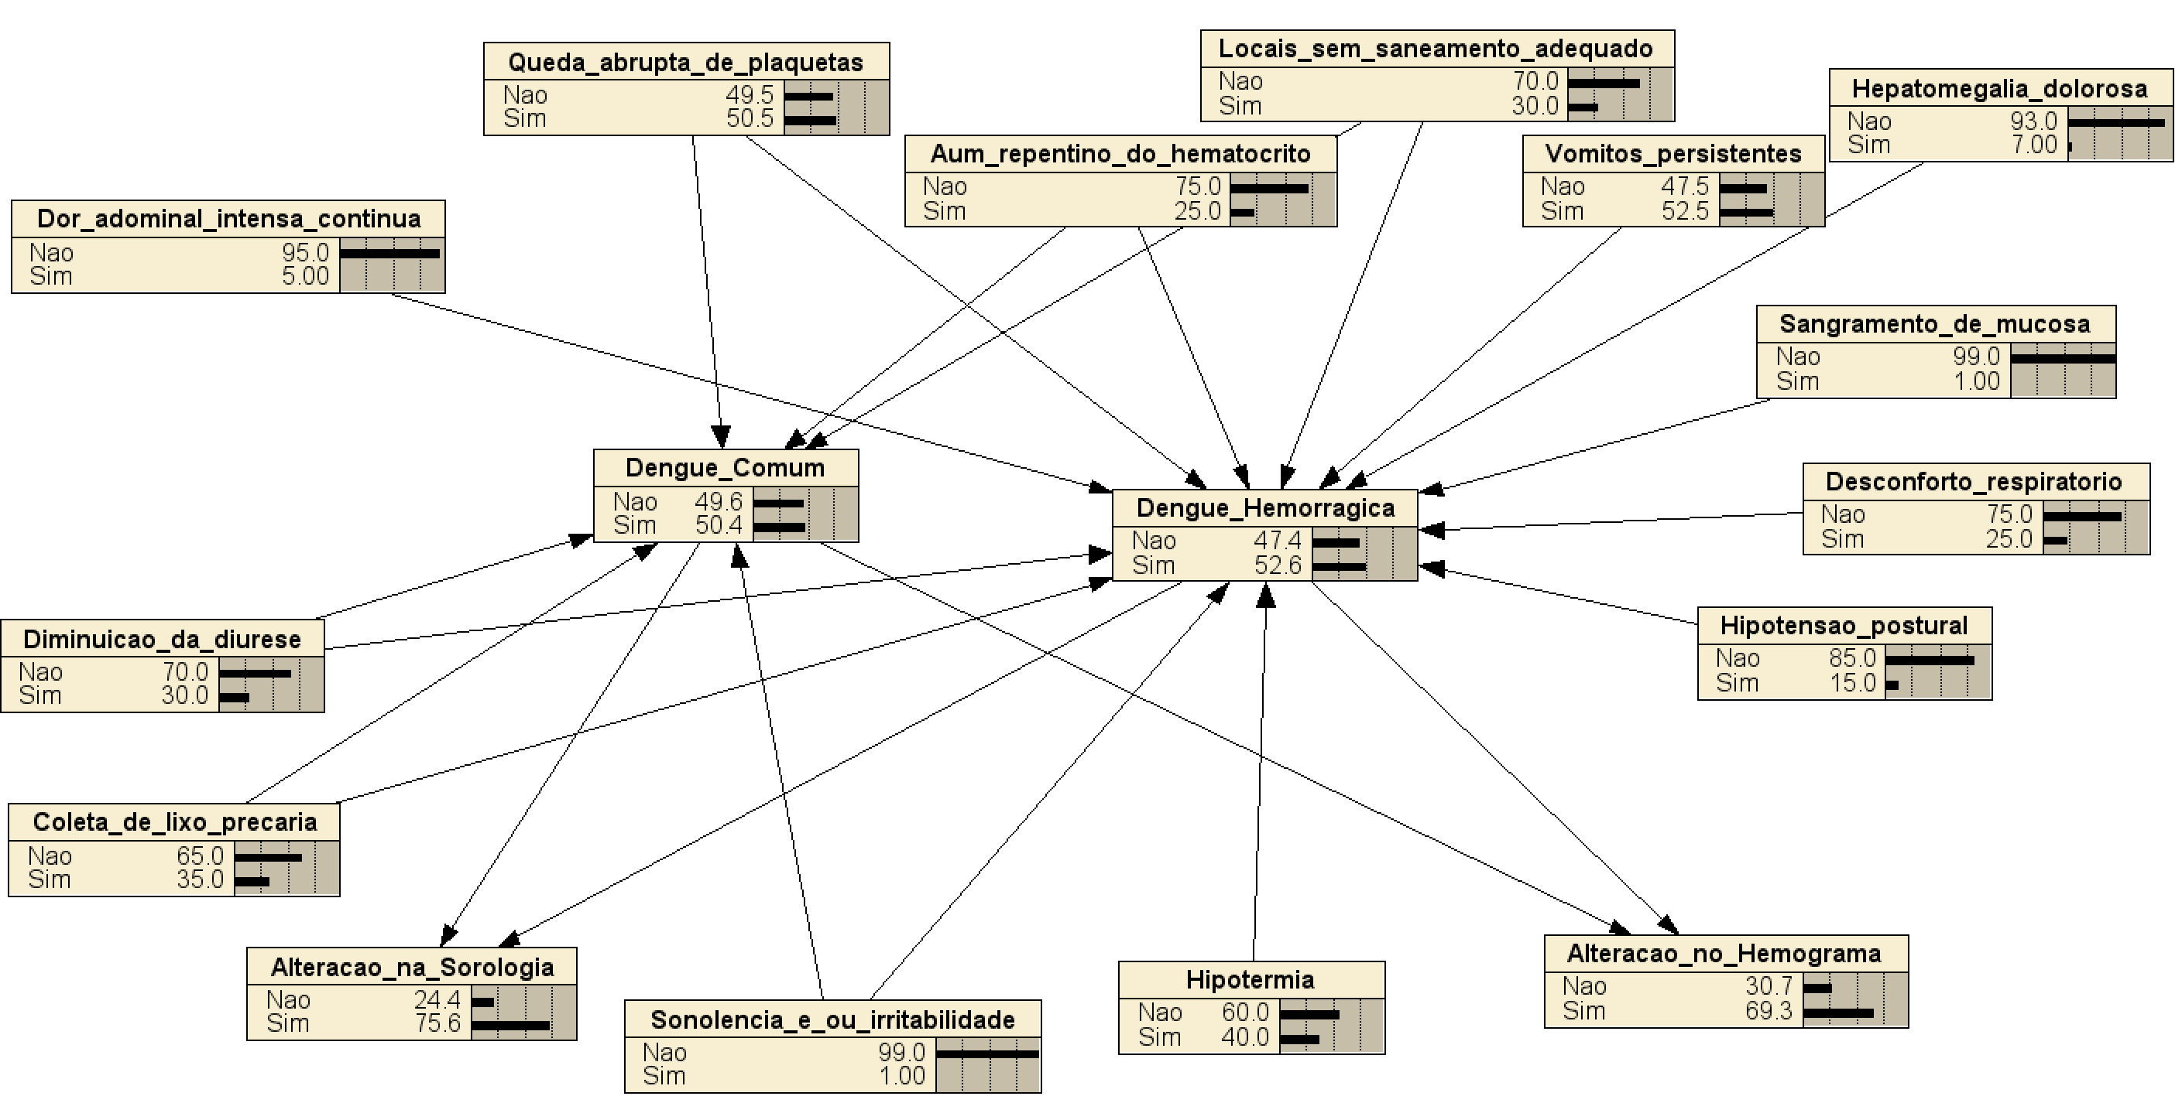
LARIISA: Bayesian Approach
Specialist Data (Tables) and Relationship

Slide 41
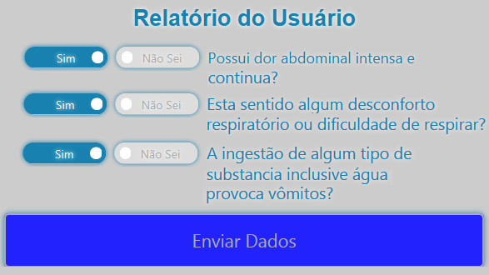




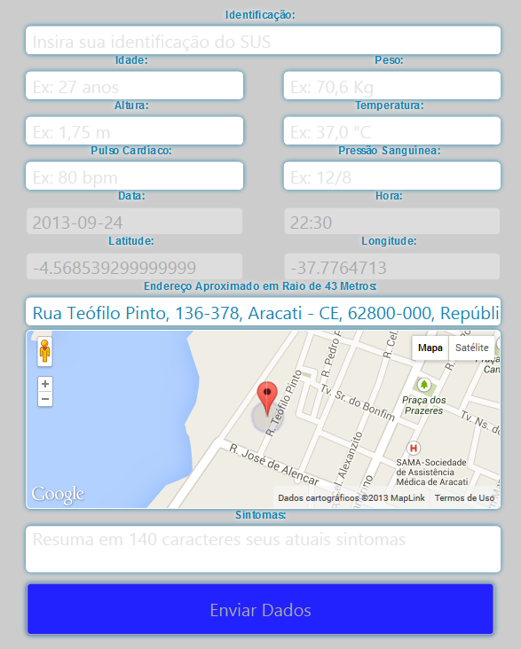
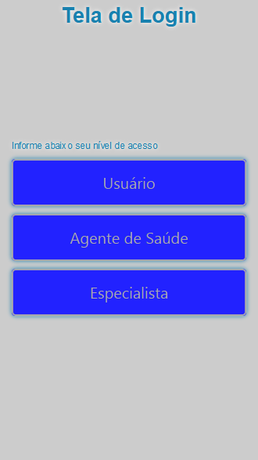



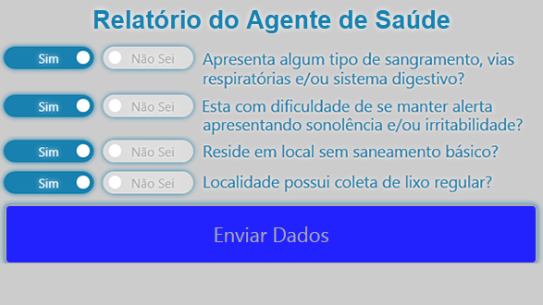







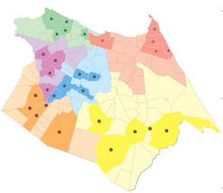
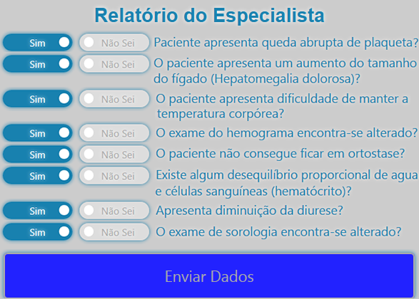
Screens of the proposed System
ENTRADA DO SISTEMA
SALA DE SITUAÇÃO
SAÍDA DO SISTEMA
Interface Módulo de Decisão
Módulo de Decisão
A’
Interface do Usuário
B’
Módulo de Inferência do LARIISA_Bay
Especialista
1
C’
Paciente
Paciente
Decisão do Especialista: f(%)
A’
A
RB
B
B’
Agente de Saúde
Gestor
2
Agente de Saúde
C’
Patient
%
Validação do Especialista:
A ⬅f(%)
A ≠ A’
C
Health Agent
A’
Posto de Saúde
Ambulância
Especialista
A
Specialist
3
B
B’
Gráfico de Epidemias
Pass Through
A ⬅f(%)
A = A’
Sensores
C
C’
METADADO
OUTROS
PROVEDORES DE CONTEXTO
LARIISA_Bay
Regras de Inferência
Repositório de Contexto Global
Repositório de Contexto Local
LARIISA
Notes:
The login screen gives you three otpions of priviledge. You can login as user/patient, as a health agent, or as a manager.

Slide 42
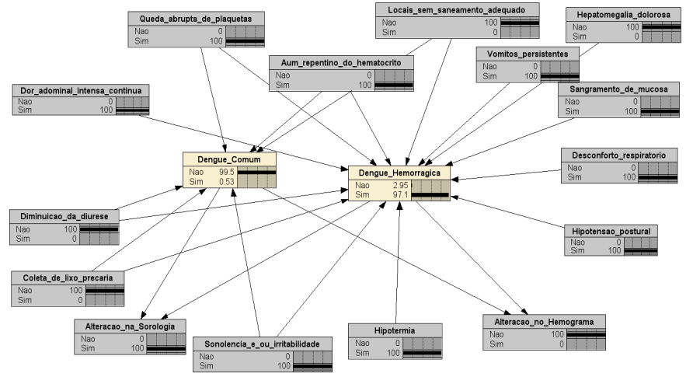
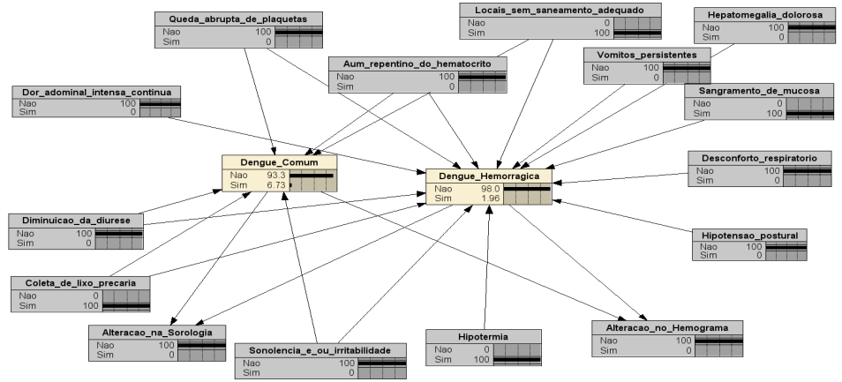
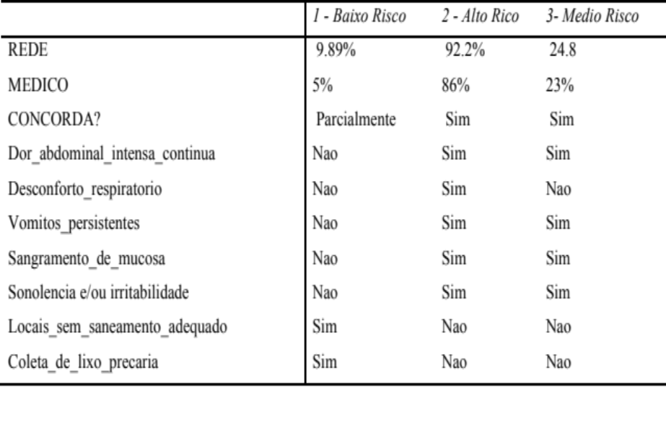
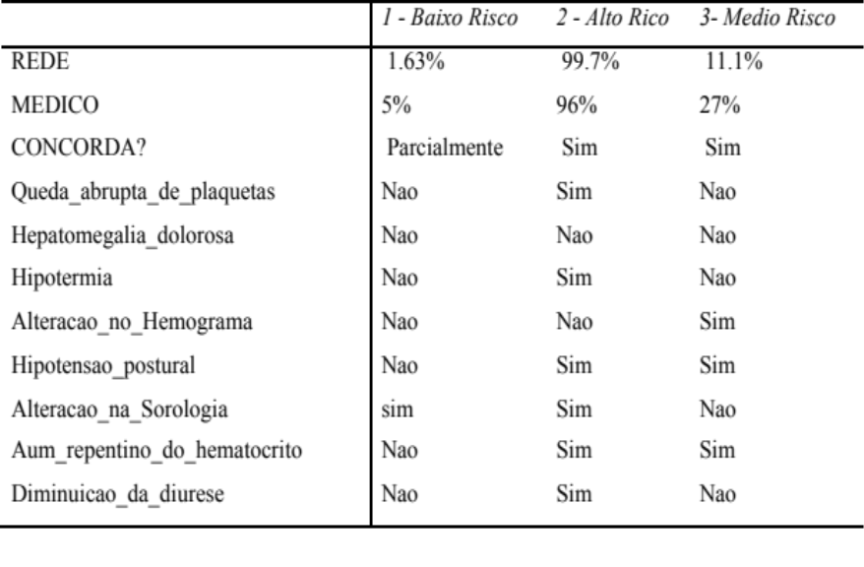
Bayesian Networks
Low Risk
High Risk

Slide 43
LARIISA: Functional Diagram
INFERENCE MODULE
IN
SITUATION ROOM
OUT
Decision Module Interface
Specialist Decision Module
A’
User Interface
LARIISA_BAY Inference Module
B’
Specialist
Patient
1
C’
Patient
Specialist Decision: f(%)
RB
A
A’
Health Agent
Manager
Health Agent
2
B
B’
%
Specialist Validation:
A ⬅f(%)
A ≠ A’
C
C’
Health Center
Ambulance
Specialist
A
A’
3
Epidemic Graph
Sensors
Pass Through
A ⬅f(%)
A = A’
B
B’
C
C’
METADATA
OTHER CONTEXT PROVIDERS
Inference Rules
Global Context Repository
Local Context Repository
LARIISA
Notes:
Hemoragic Dengue, Dengue, Normal

Slide 44
5. LARIISA Prototypes
- Caregiving (2014)

Slide 45
LARIISA: Caregiver Case Study
Knowledge Representation
(ONTOLOGY)
Data Acquisition
(CONTEXT)
METADATA
DECISION-MAKING
Notes:
Here you can see the whole vision of the proposed system, where data collected from patients (it is important to notice that the system can be used by users/patients, health agents and health managers or specialists) are sent to the LARIISA database, and then the system is able to take decisions taking into account local context (related to individuals) or global context (related to epidemic cases). System can take the decision to just advise the patient to go to the nearest hospital center, or send a health agent to visit the patient, or in an urgent case send an ambulance to the patient.

Slide 46

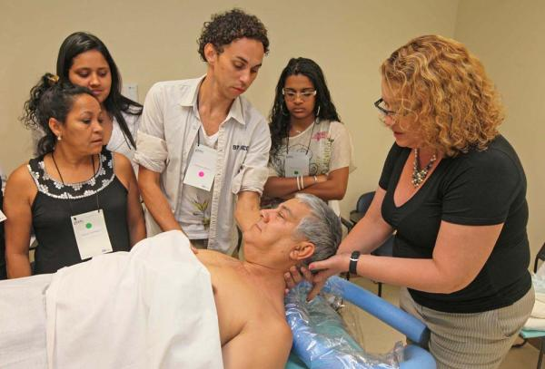
Scenario for LARIISA Application
CAREGIVER – a voluntary or paid person who helps an impaired person to deal with his/her daily activities.
2. Motivation:
The Brazilian Digital TV
LARIISA can help
specialized profissional
... or voluntary people

Slide 47
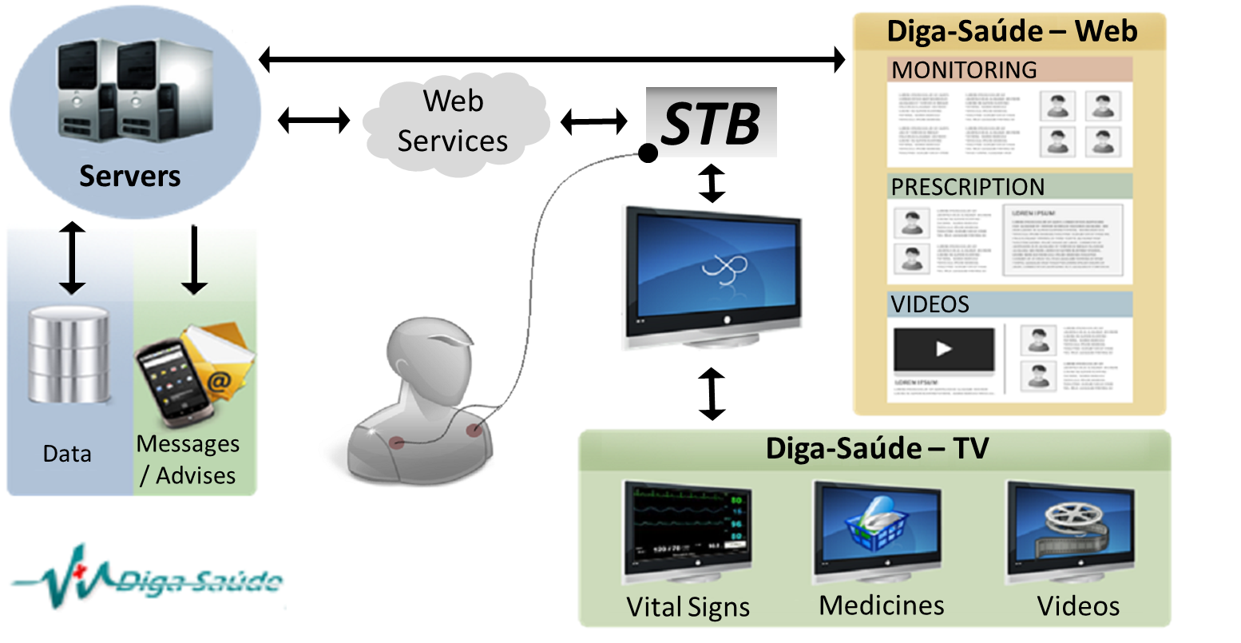
Data acquisition – Diga Saude CONTEXT
Prague, Czech Republic July/2013

Slide 48
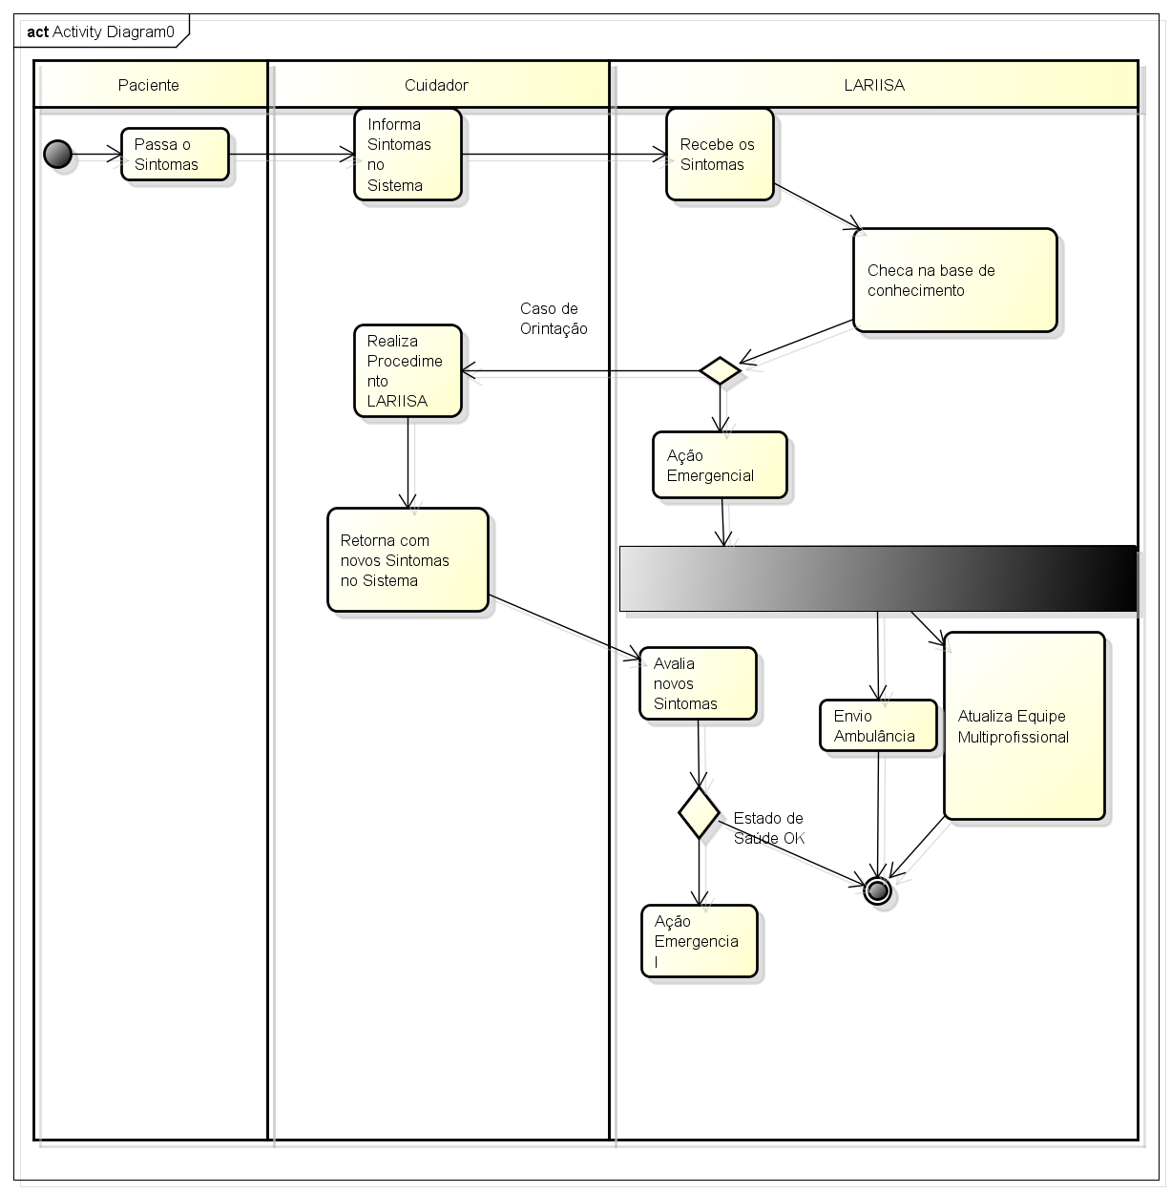

Slide 49
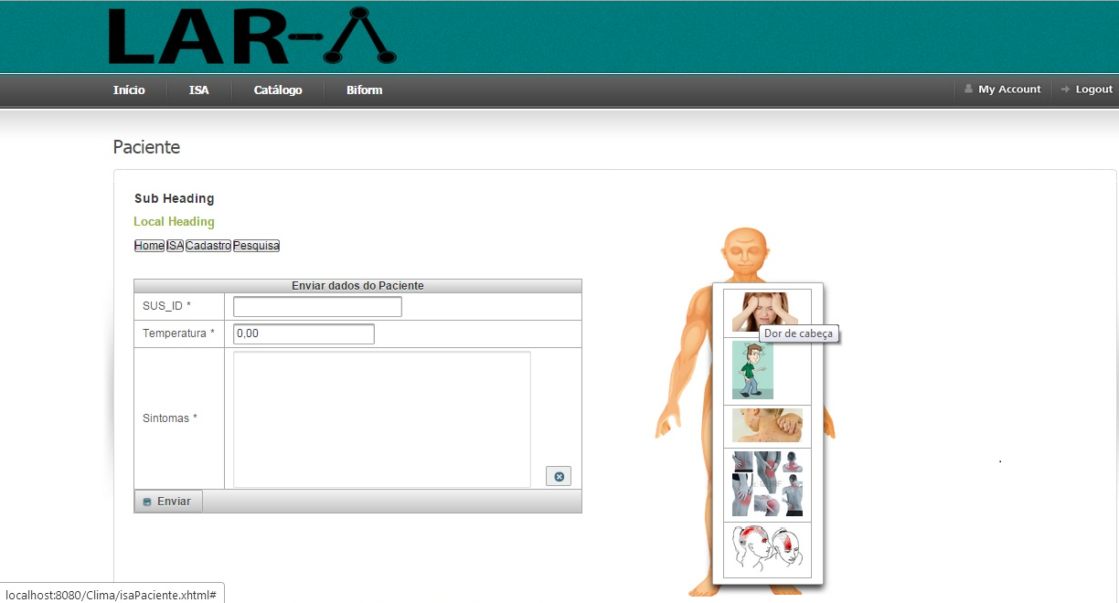
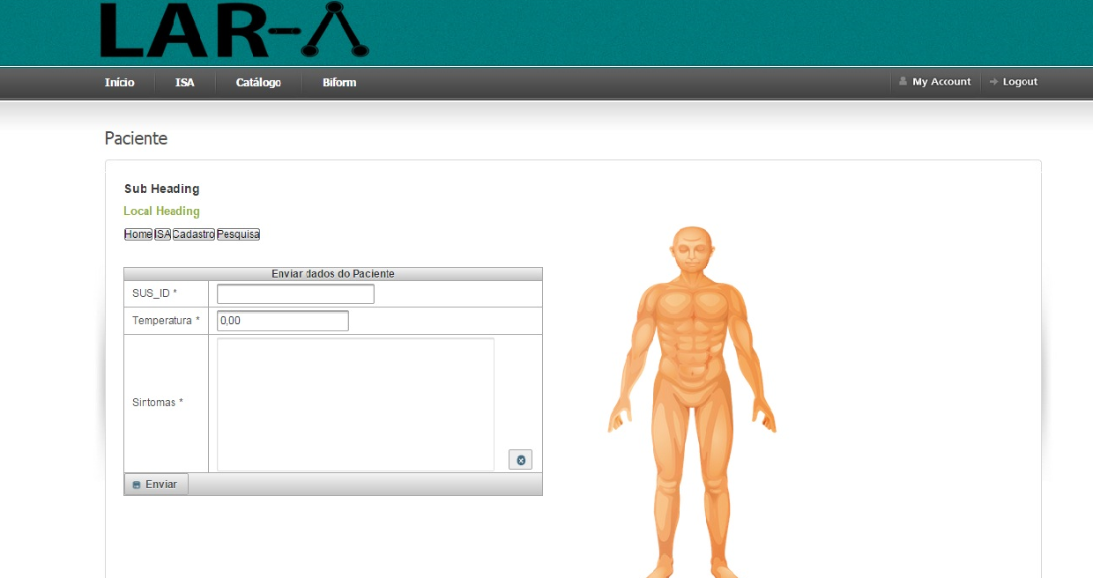
Interface for non alphabetized people
Prague, Czech Republic July/2013

Slide 50
5. LARIISA Prototypes
- Car Aciddent (2015)

Slide 51
LARIISA: Dengue Fever Case Study
Knowledge Representation
(ONTOLOGY)
Data Acquisition
(CONTEXT)
METADATA
Step 1
Step 2
DECISION-MAKING
Step 3
Notes:
Here you can see the whole vision of the proposed system, where data collected from patients (it is important to notice that the system can be used by users/patients, health agents and health managers or specialists) are sent to the LARIISA database, and then the system is able to take decisions taking into account local context (related to individuals) or global context (related to epidemic cases). System can take the decision to just advise the patient to go to the nearest hospital center, or send a health agent to visit the patient, or in an urgent case send an ambulance to the patient.

Slide 52
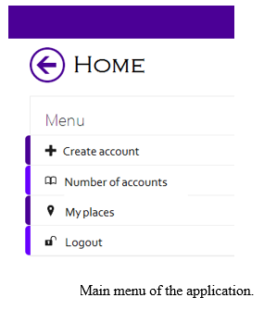
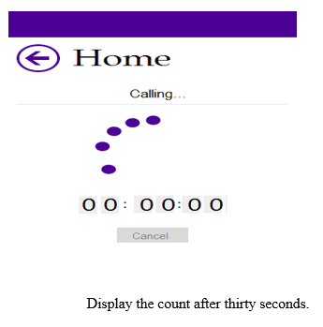
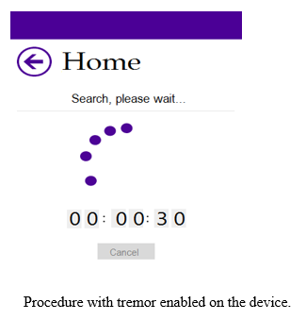
5Car Accident Interface
When the smartphone feels a tremble, a screen will indicate that a countdown of thirty seconds has started.
On this same screen, the option to disable is shown.
In parallel, a message informs you that the application is looking for the coordinates of the crash site.

Slide 53
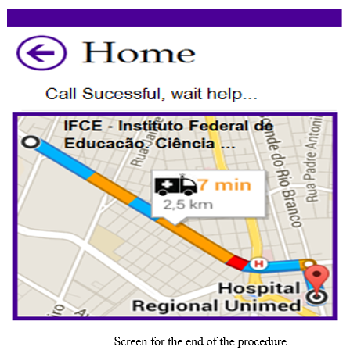
Health Agent
Combining geolocation with opportunistic networks, we adopt a mechanism that searches for landmarks around the accident.

Slide 54
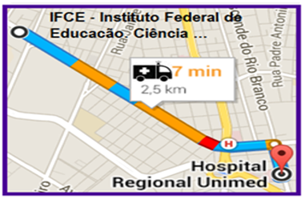
LARIISA: URGENCY CARE IN CAR ACCIDENTS
ONTOLOGY
&
BAYESIAN NETWORKS
Data Acquisition
(CONTEXT)
METADATA
DECISION-MAKING
Notes:
CONTRIBUI;CÃO
COMO FOI DITO NO INICIO DA APRESENTAÇÃO ...
ESTE TRABALHO OBJETIVA A DEFINIÇÃO, ESPECIFICAÇÃO E A IMPLEMENTAÇÃO DE UM MODELO PARA TRATAR INCERTEZAS NAS INFORMAÇÕES DE CONTEXTO E NA REPRESENTAÇÃO DO CONHECIMENTO NO PROJETO LARIISA.
UMA OUTRA CONTRIBUIÇÃO É A POSSIBILIDADE DO NOSSO MODELO SERVIR DE ENTRADA PARA UM SISTEMA DE DETECCAO E MONITORAMENTO DE EPIDEMIA DE DENGUE.

Slide 55
6. LARIISA Next Generation
- An Intelligent Classifier for LARIISA
- LARIISA Cube

Slide 56
6. LARIISA Next Generation
- An Intelligent Classifier for LARIISA

Slide 57
LARIISA: Next Generation
ONTOLOGY
BAYESIAN NETWORKS
DATA MINING
Data Acquisition
(CONTEXT)
METADATA
DECISION-MAKING
Notes:
CONTRIBUI;CÃO
COMO FOI DITO NO INICIO DA APRESENTAÇÃO ...
ESTE TRABALHO OBJETIVA A DEFINIÇÃO, ESPECIFICAÇÃO E A IMPLEMENTAÇÃO DE UM MODELO PARA TRATAR INCERTEZAS NAS INFORMAÇÕES DE CONTEXTO E NA REPRESENTAÇÃO DO CONHECIMENTO NO PROJETO LARIISA.
UMA OUTRA CONTRIBUIÇÃO É A POSSIBILIDADE DO NOSSO MODELO SERVIR DE ENTRADA PARA UM SISTEMA DE DETECCAO E MONITORAMENTO DE EPIDEMIA DE DENGUE.

Slide 58
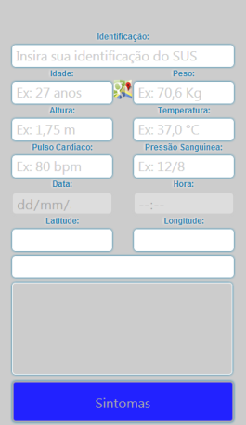
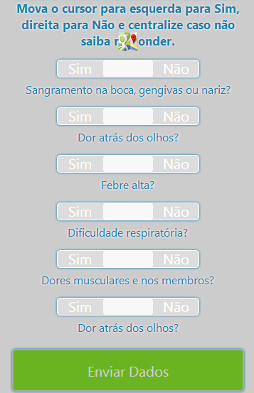
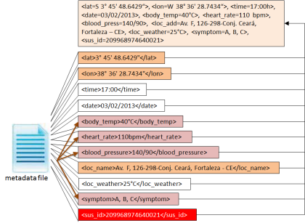
Clariisa Evolution - Classifier
Training set
Data
Acquisition
Web
Application
Pattern 1
Pattern 2
. . .
Pattern n
Undersample
Metadata
Non-target patterns
Target patterns
Raw data extraction
Predictive labeling
Health
diagnosis
database
Feature selection
Pattern building

Slide 59
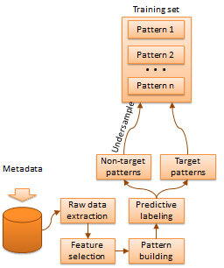
NEW METHODOLOGY
Used for building the test and training sets to be submitted to the classifiers.
Find an optimal model to predict the development of heart diseases based on this type of data.
Step 1: Extract raw data from the database, which contains usage information of the beneficiaries;
Step 2: Perform feature selection;
Step 3: Find every patient that did a health diagnosis somewhere in the analyzed period of time;

Slide 60
Step 4: For each patient’s diagnosis data found on Step 3, build a pattern considering a procedure window counted from the first time a target diagnosis was done (target patterns);
Step 5: Find every patient that have never had a disease during the same time period;
Step 6: For each patient found on Step 5, build patterns considering a procedure window counted from each available month. Note that each reference month generates a distinct pattern per patient.
(non-target patterns);
Step 7: Obtain a training set formed by every target pattern and the same quantity of nontarget patterns, randomly sampled.

Slide 61
Clariisa Evolution - Classifier
Target patients
Active health data (per SUS_ID)
Non-target patients
Set of test patterns
Intelligent system choosen (bayesian networks or ontology) based on classifier mechanism
Health diagnosis provided through the best intelligent system choosen by the prototype
Classifier mechanism

Slide 62
6. LARIISA Next Generation
- LARIISA Cube

Slide 63
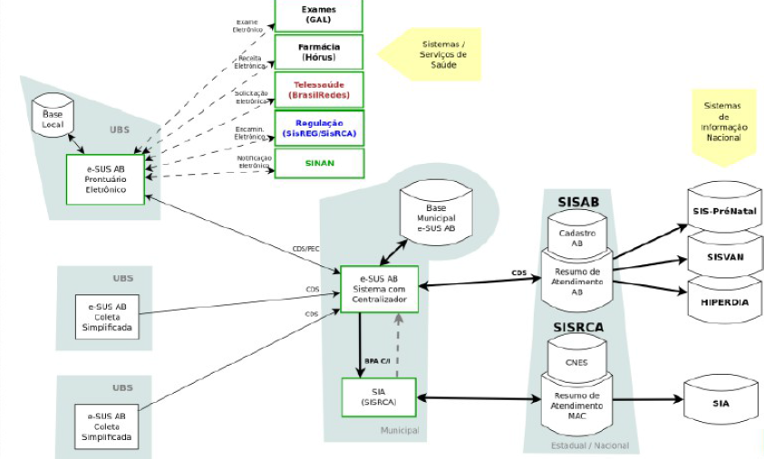
- LARIISA Cube

Slide 64
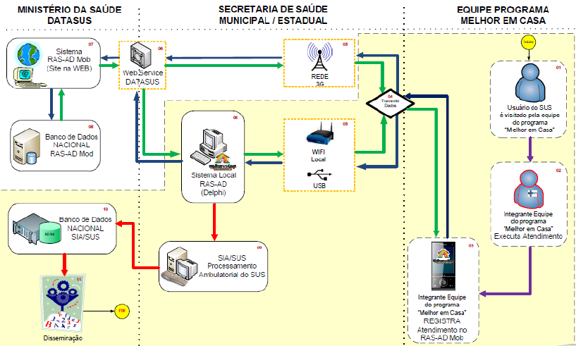
- LARIISA Cube

Slide 65
LARIISA Architecture: a context-aware framework
Data Acquisition
Context Providers
User
Device
Internet
Health Agent Device
Symptoms + sus_id
Data Processing
Metadata
Publishing
Security Protocol
Context Aggregator (CA)
Inference Rules
Global Context
Local
Context
Health Managers System
Notes:
The whole arquitecture of the system is presented here. Data Acquisition collects and enriches all important data to provide a diagnosis of the patient. Data processing layer then builds the metadata, and this metadata is sent to the database. To address privacy problem, all data are transmitted thorugh the Internet using TLS protocol. As you can notice here, the system is also able to rise additional questions to the patient according with his or her vital signs and symptoms.

Slide 66
Knowledge
Management
INTELLIGENCE FOR
DECISION- MAKING PROCESS IN
E-HEALTH SYSTEMS
Shared
Information
Normative
Administration
Clinical Epidemiology

Slide 67
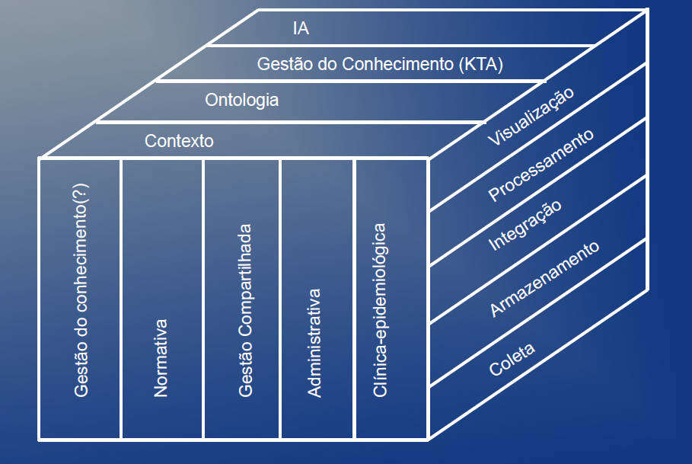
Administrative
Systemic Normative
Shared Management
Clinical & Epidemiology
Context-Aware Service (CAS)
Privacy Policy Manager (PPM)

Slide 69

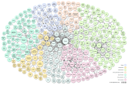
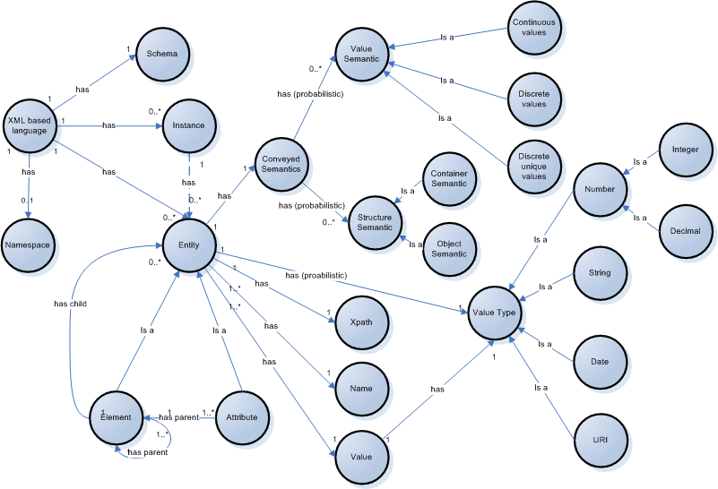
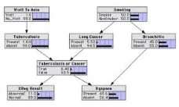
Service Adapter (SA)
Administrative
Systemic Normative
Shared Management
Clinical & Epidemiology
Context-Aware Service (CAS)
Context Reasoner (CR)
Visualization
Context Aggregator (CA)
Health Context Information
Inference Rules
QoC Evaluator (QoCE)
Query Adapter (QA)
Geolocation Classifiers
Knowledge Management (KTA)
Processing
Artificial Intelligence
Linked Data Mashups
Integration
Storage
Privacy Policies
Privacy Policy Manager (PPM)
Collect
Global Context Repository
Health Agent`s Agenda
Health Agent`s Database
Ontology
Bayesian Networks
Metadata (MTD)
Health Agent and Users`s Mobile Device (MD)
Context Provider (CP)
Context Provider (CP)
Set Top Box
Local Context Repository
S
S
S
S
S
S
S
S
S
Embedded Sensors
Environmental Sensors
Helath Sensors

Slide 70
7. Conclusion

Slide 71




Sponsors
This project is being sponsored since 2004 by
the Science and Technology Ministry of Brazil and others
Brazilian Research Agencies
It will be applied to the brazilian public health system (SUS)
CNPq
2006 - Diga Saude (FUNCAP)
2010 - LARIISA (CNPq / CAPES)
2012 - Cloud LARIISA (IFCE)
2013 - SISA (FIOCRUZ)
2014– NextSAUDE (FUNCAP)
2015 - GISSA (FINEP)
Conclusão

Slide 72
The CLARIISA project will be applied to the SUS,
The brazilian public health system
  ACADEMIC RESULTS
  10 Master of Science
  12 papers
  03 research projects
  INOVATION ASPECTS
  A Proof of Concept of the LARIISA Applications is being implemented by the IT companies in Brazil
  The DIGA Saúde prototype is held by the COELCE (Electricity Company of Ceará State – Brazil)

Slide 73


